Slide 1


Slide 2
 |  | Difficulty
 | Python
Super fast, super optimized applications. Also, primitive embedded systems. | The C languages: C, C++, C#
 | Java
 | If you're trying to understand security stuff on corporate networks, you need to be intimately familiar with Windows.

Slide 3
Measured Applause: Toward a Cultural Analysis of Audio Collections

Slide 4
Overall questions
What are salient, interesting features? And to whom? For what questions?
What do we call them? And does it matter?

Slide 5
So, what if?
“ . . . the sound file would become . . . a text for study, much like the visual document. The acoustic experience of listening to the poem would begin to compete with the visual experience of reading the poem.”
Bernstein, Charles. Attack of the Difficult Poems: Essays and Inventions. University Of Chicago Press, 2011, 114.

Slide 6
A supposition
In Digital Humanities, text mining is a logocentric practice.
This practice of text mining presupposes a binary logic; there is meaning in the results or there is not.
When engaged in this kind of text mining, we are reinscribing the simplest meaning of The Word.
Sound, by comparison, is aporetic.

Slide 7
Driving research questions:
What does it mean to study culture through sound recordings? Is it fundamentally different than studying culture through text? What do we learn from that difference?
How do we articulate “the acoustic experience” in the context of (digital) audio? To ourselves? To our students and colleagues? To our machines?
What impact does the digital experience of such acoustics have on how we access and understand our cultural heritage?

Slide 8
Two parts
Introducing High Performance Sound Technologies for Access and Scholarship (HiPSTAS)
Case Study: Applause in PennSound

Slide 9
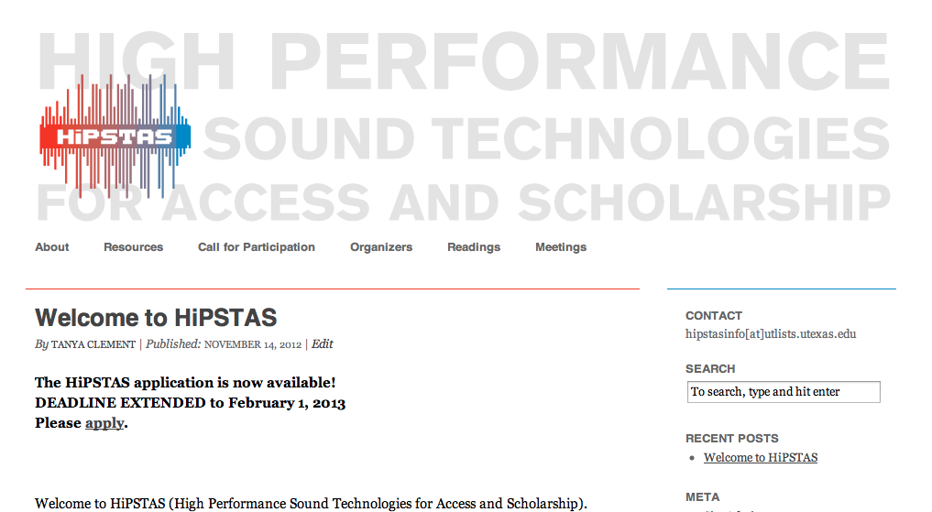

http://www.hipstas.org

Slide 10
HiPSTAS team
Tanya Clement, [PI] Assistant Professor, University of Texas at Austin
Loretta Auvil [Co-PI] Senior Project Coordinator at the Illinois Informatics Institute (I3) at the University of Illinois at Urbana-Champaign
David Tcheng [Co-PI] Research Scientist at I3; ARLO developer
Tony Borries, Research Programmer working as a consultant with I3; ARLO programmer
David Enstrom, Biologist, University of Illinois at Urbana-Champaign; consultant
Steve McLaughlin, PHD student, UT School of Information

Slide 11
HiPSTAS Institute, 2013-2014
9 librarians and archivists
8 humanities scholars
3 advanced graduate students in humanities and information science

Slide 12
Participating collections
poetry from PennSound at the University of Pennsylvania 30,000 hours of audio
folklore at the Dolph the Briscoe Center for American History at UT Austin, 57 feet of tapes (reels and audiocassettes)
storytelling traditions at the Native American Projects (NAP) at the American Philosophical Society in Philadelphia , 50 tribes, 3,000 hours

Slide 13
Other Collections of interest to HiPSTAS Participants
Field recordings (200,000 recordings) American Folklife Center, Library of Congress
30, 000 hours, Oral histories, Storycorps
Speeches in the Southern Christian Leadership Conference recordings, Emory University
700 recordings in the Elliston Poetry Collection at the University of Cincinnati
36 interviews in the Dust, Drought and Dreams Gone Dry: Oklahoma Women and the Dust Bowl (WDB) oral history project out of the Oklahoma State Libraries

Slide 14
HiPSTAS: primary goals
To develop a virtual research environment in which users can better access and analyze spoken word collections of interest to humanists through:
an assessment of scholarly requirements for analyzing sound
an assessment of technological infrastructures needed to support discovery
preliminary tests that demonstrate the efficacy of using such tools in humanities scholarship
A freely available, open-source, API-driven version for general use

Slide 15
1st: What do humanists talk about when we talk about sound?
Language dynamics: tempo, pitch, tone/timbre, volume, pace, laughter, silence, applause, moans, screams, dialects, changing speakers, gender, age, changing genres
Environment: fan hums, car horns, chickens, train whistles, bird calls, frogs mating
Materiality: recording noises, needle drops, feedback, the electronic grid, changing tracks

Slide 16
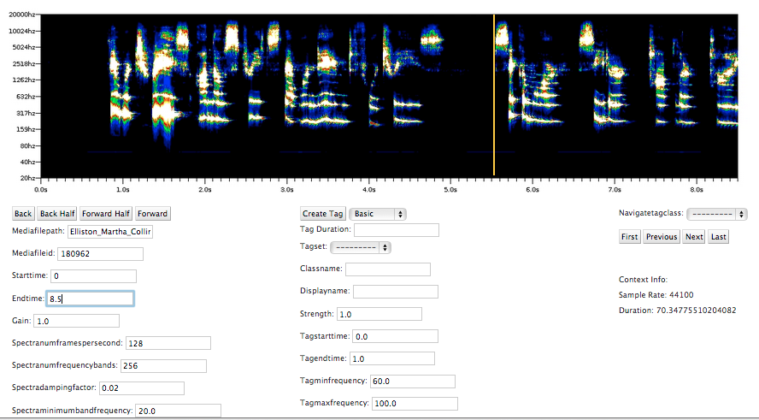
What do features do we talk about when we talk about audio?
Damping ratios, gain, frequencies, spectra, energy, and pitch energy
NOT Words!!

Slide 17
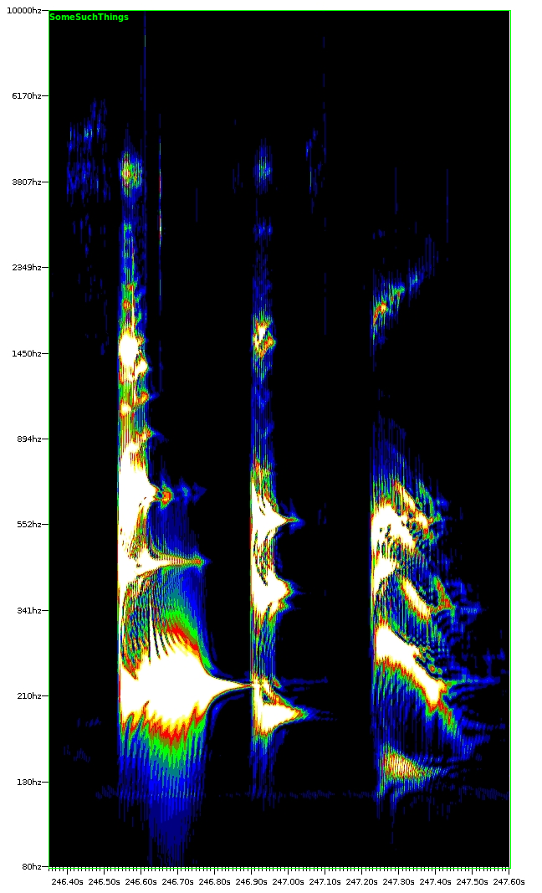
ARLO (Adaptive Recognition with Layered Optimization)
Energy represented by
a heat based color scheme.
White – hottest, most intense
Yellow
Red
Green
Blue
Black – coolest, least intense
HZ, a unit of
frequency
Time
Notes:
ARLO extracts features based on time and frequency information in the form of a spectrogram computed using band-pass filters linked with energy detectors.

Slide 18
Why FB? Why not FFT?
frequency data in FFT (Fast Fourier Transform) is set by sample rate and window size
FB method: like an array of tuning forks, each positioned at a separate frequency, an approach that is thought to best mimic the processes of the human ear (Salthouse and Sarpeshkar, 2003)
FB method: users can optimize trade-off between time and frequency resolutions in the spectrograms by choosing a frequency range and 'damping factor’ --a parameter that decides how long tuning forks 'ring.’
By selecting these features, users can optimize their searches for a given sound pattern.
Rhythm vs. tone, for example

Slide 19
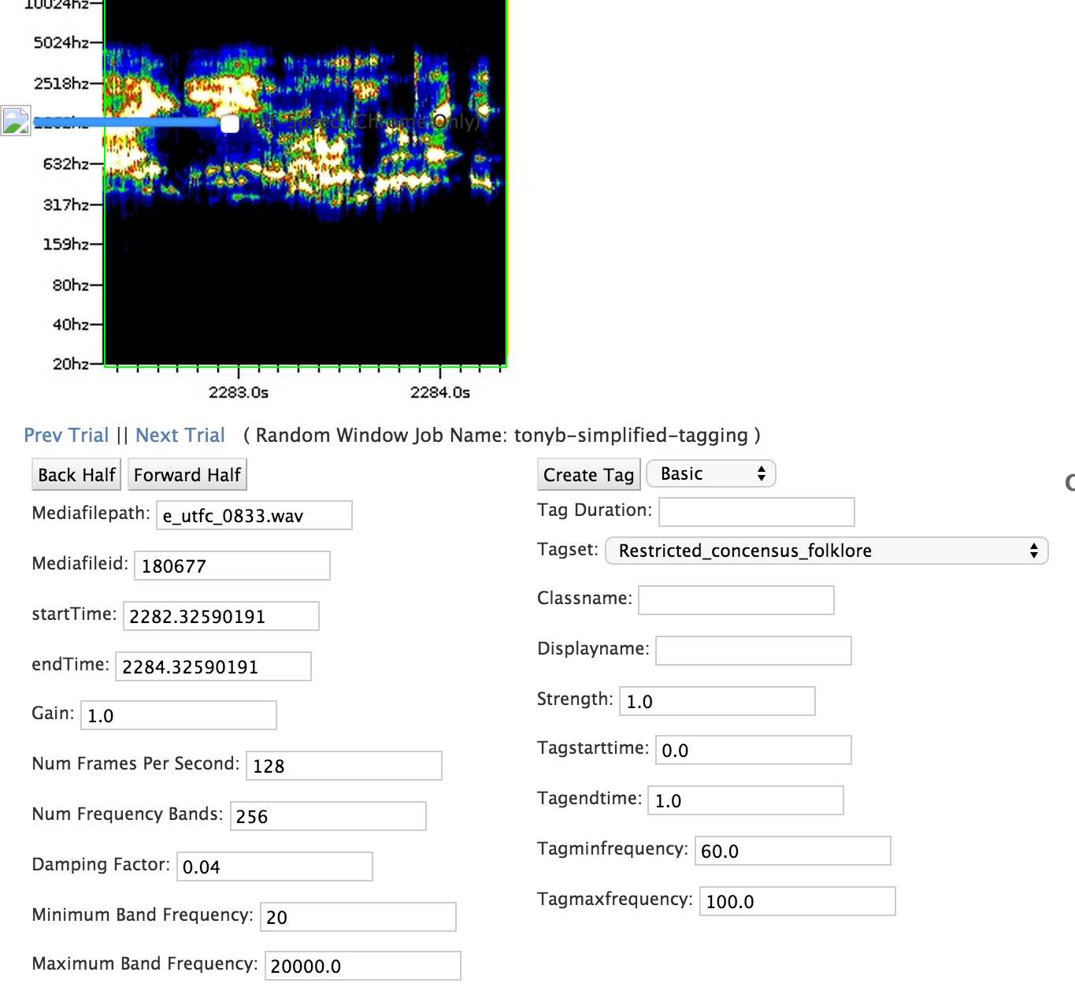
ARLO: choosing parameters

Slide 20
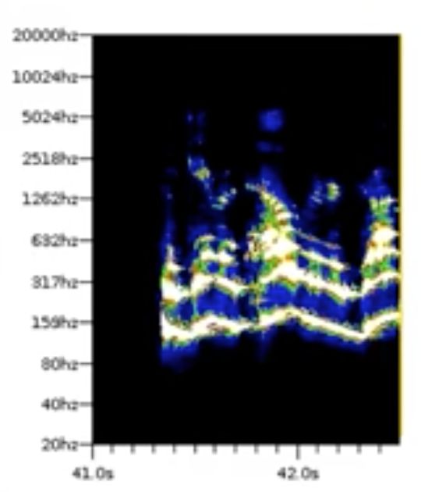
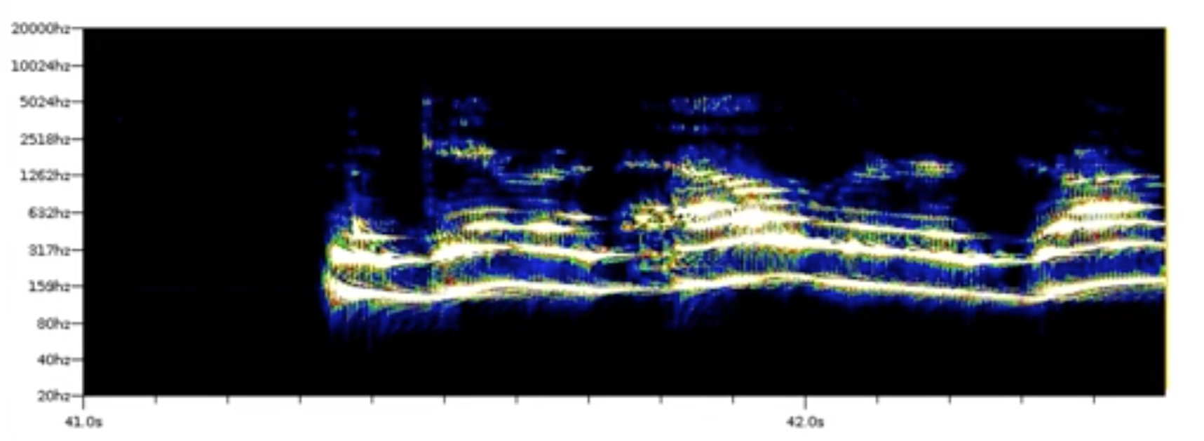
128 frames per second
500 frames per second
Notes:
128-500 , .02-.04 damping factor, .08; gain 1.0, gain 4.0

Slide 21
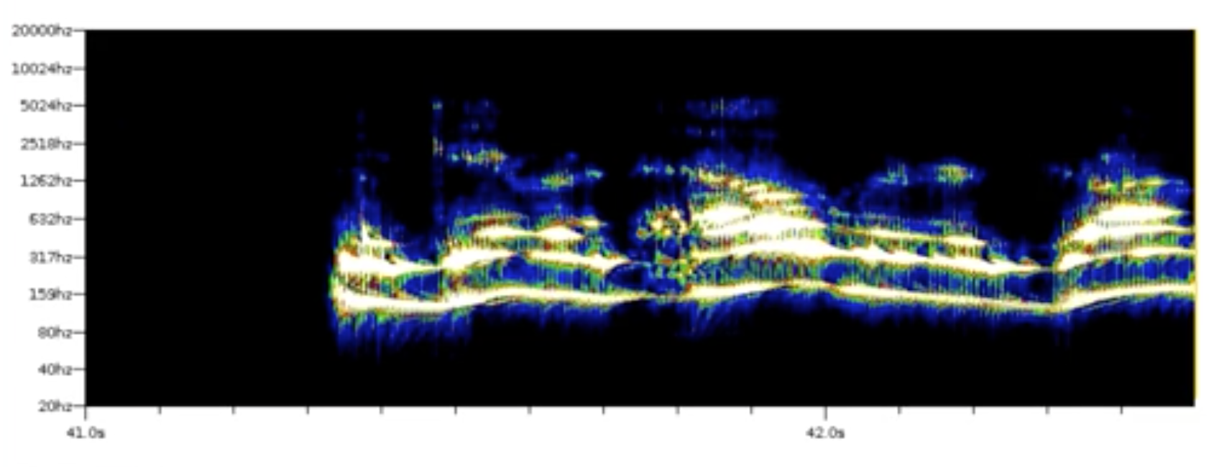
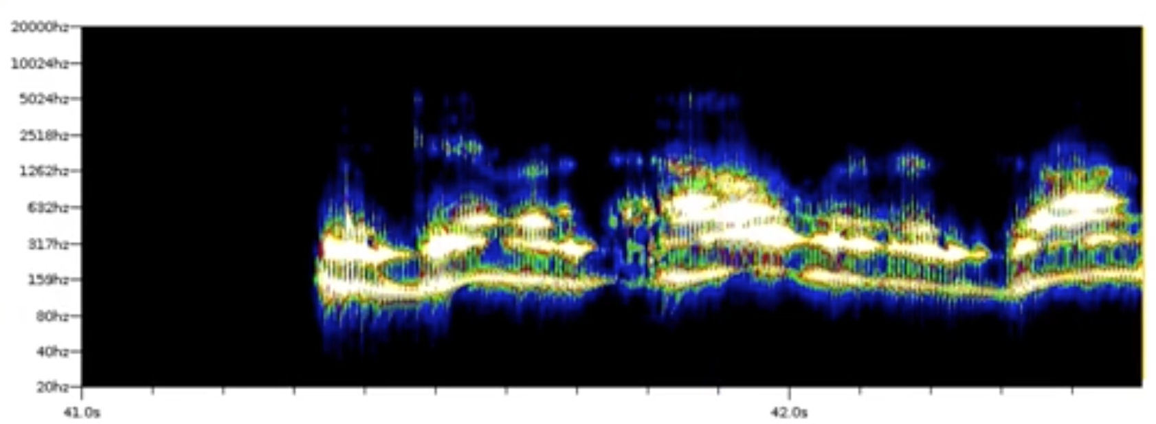
damping factor: .02
damping factor: .04
damping factor: .08
Notes:
This parameter represents how quickly the band responds to changes in the audio event. This is equivalent to designating how much "drag" is on the tuning fork or human hair or how quickly the tuning fork will stop ringing. It ranges between 0 and 1. A high damping factor (.9) is best for examining quick rhythmic features. A low damping factor (.001) is better for detecting a faint sound of a mechanical hum or a fan in the background that does not change pitch. If you want to focus on the harmonic structure of a voice, "halve" the damping factor and increase the frames per second to 200 times per second. Lowering the damping ratio gives more information about pitch.

Slide 22
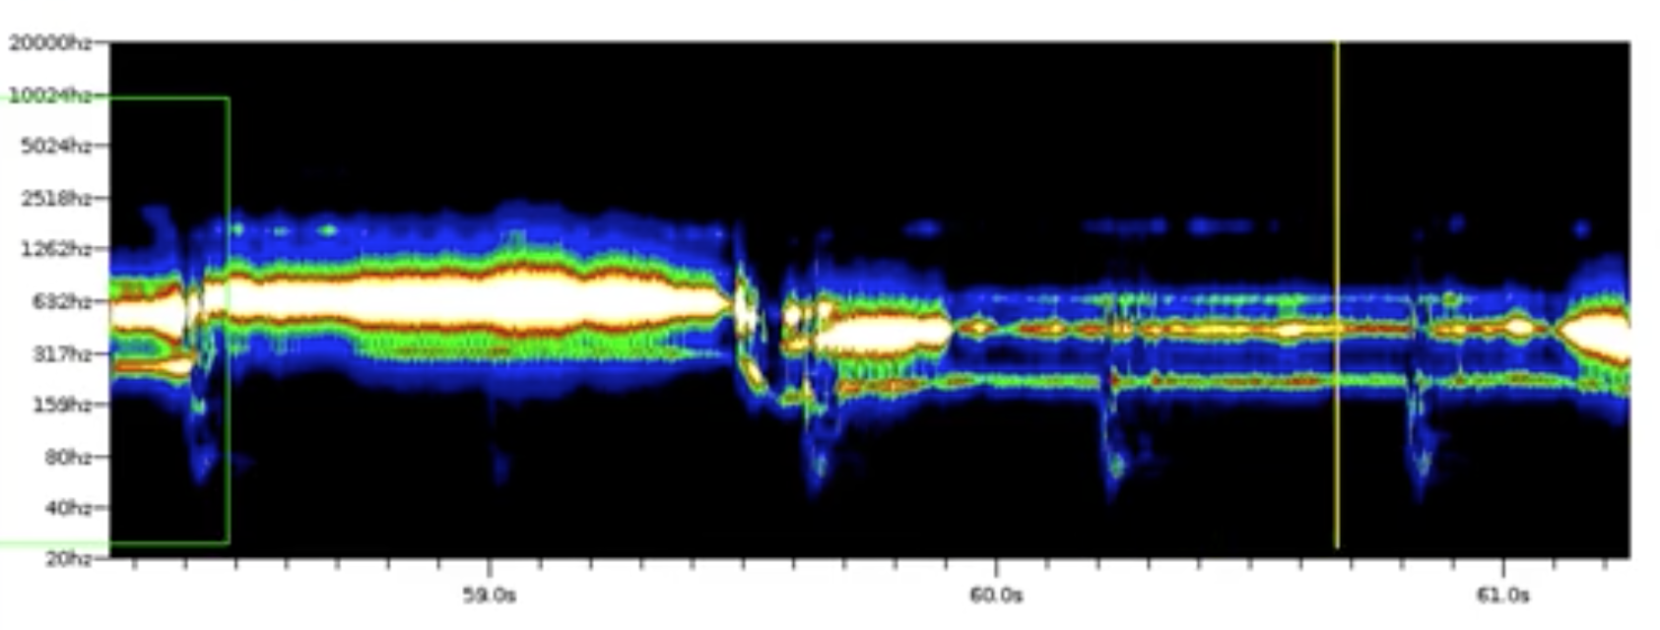
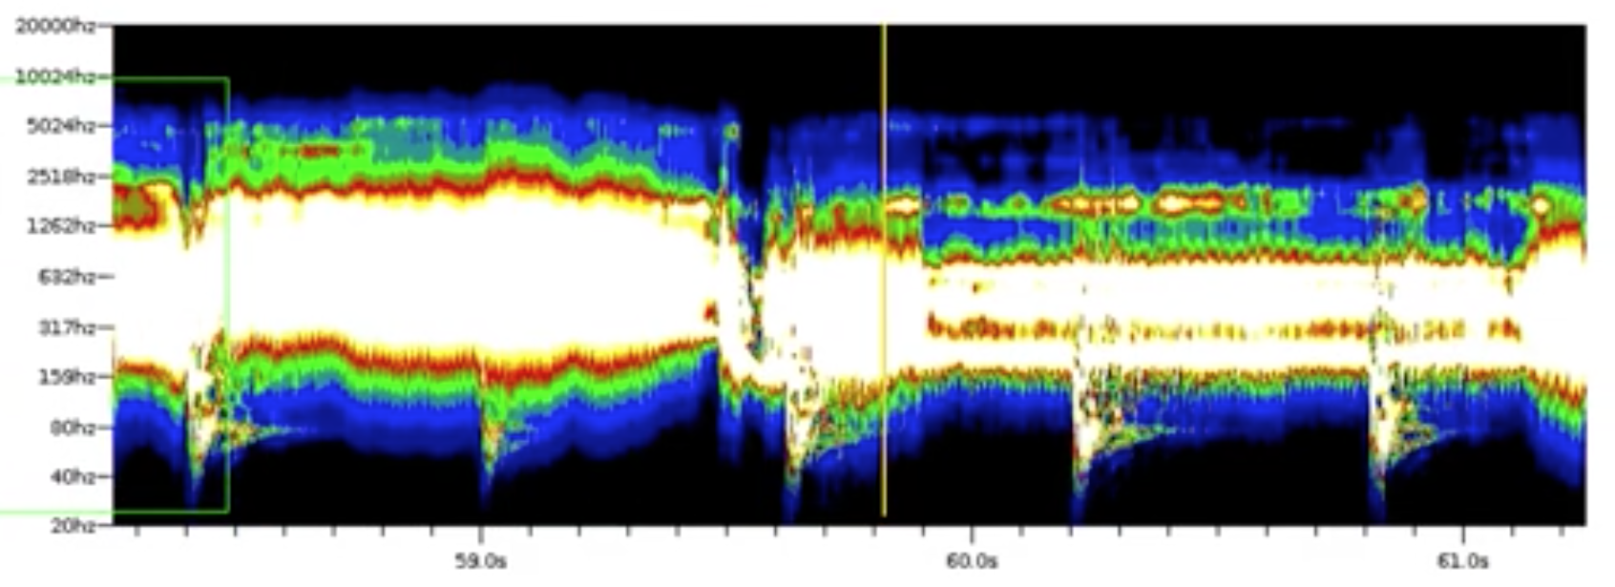
Damping factor: .08; gain 1.0
Damping factor: .08; gain 4.0
Notes:
Changing the gain will allow you to see data at different frequencies. This is useful if you are interested in looking at information about low level noises like hums, pops, crackles or the other noises that sound recording and playback technologies make. Turning the gain "up" to a "2", a "4", or an 8 shows background noise or more subtle noises. Turning it "down" shows louder, more pronounced sounds. Around 60 or 120 hz, you might see the "60 cycle hum" or the pulsing of electricity. Recordings make different "hisses" depending on age of the recording.

Slide 23
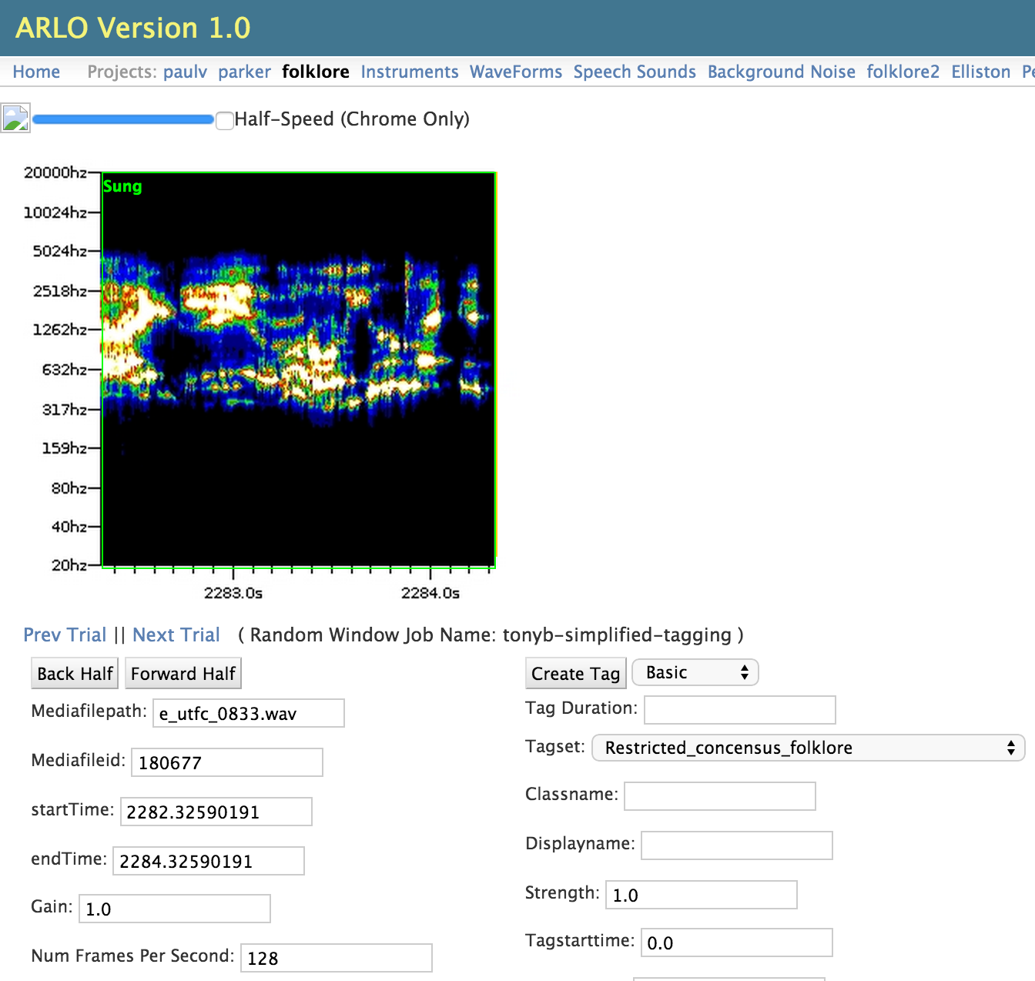
ARLO: pick features, label examples

Slide 24
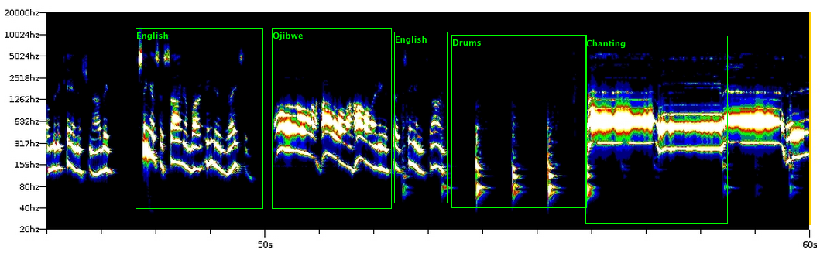
ARLO: human labeling examples
English, Spoken Ojibwe, English, Drums, Chanting
Notes:
128-500 , .02-.04 damping factor, .08; gain 1.0, gain 4.0

Slide 25
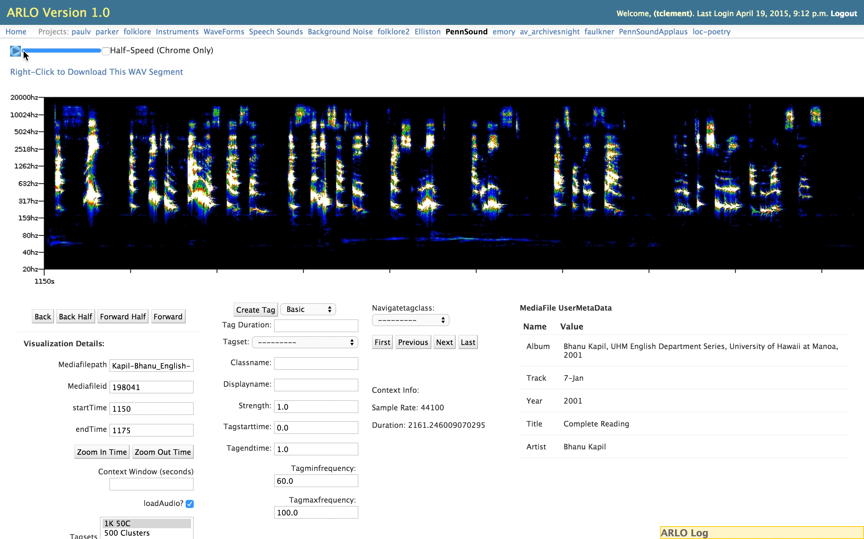
Bhanu Kapil, University of Hawaii, Manoa, 2001

Slide 26
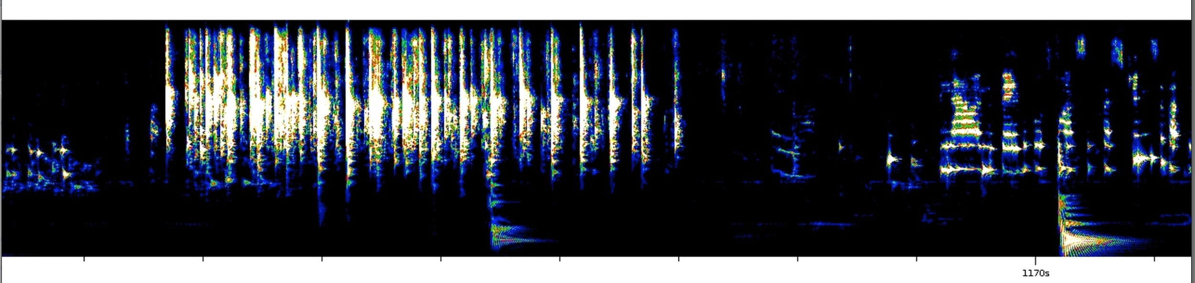
ARLO: machine labeling examples
applause

Slide 27
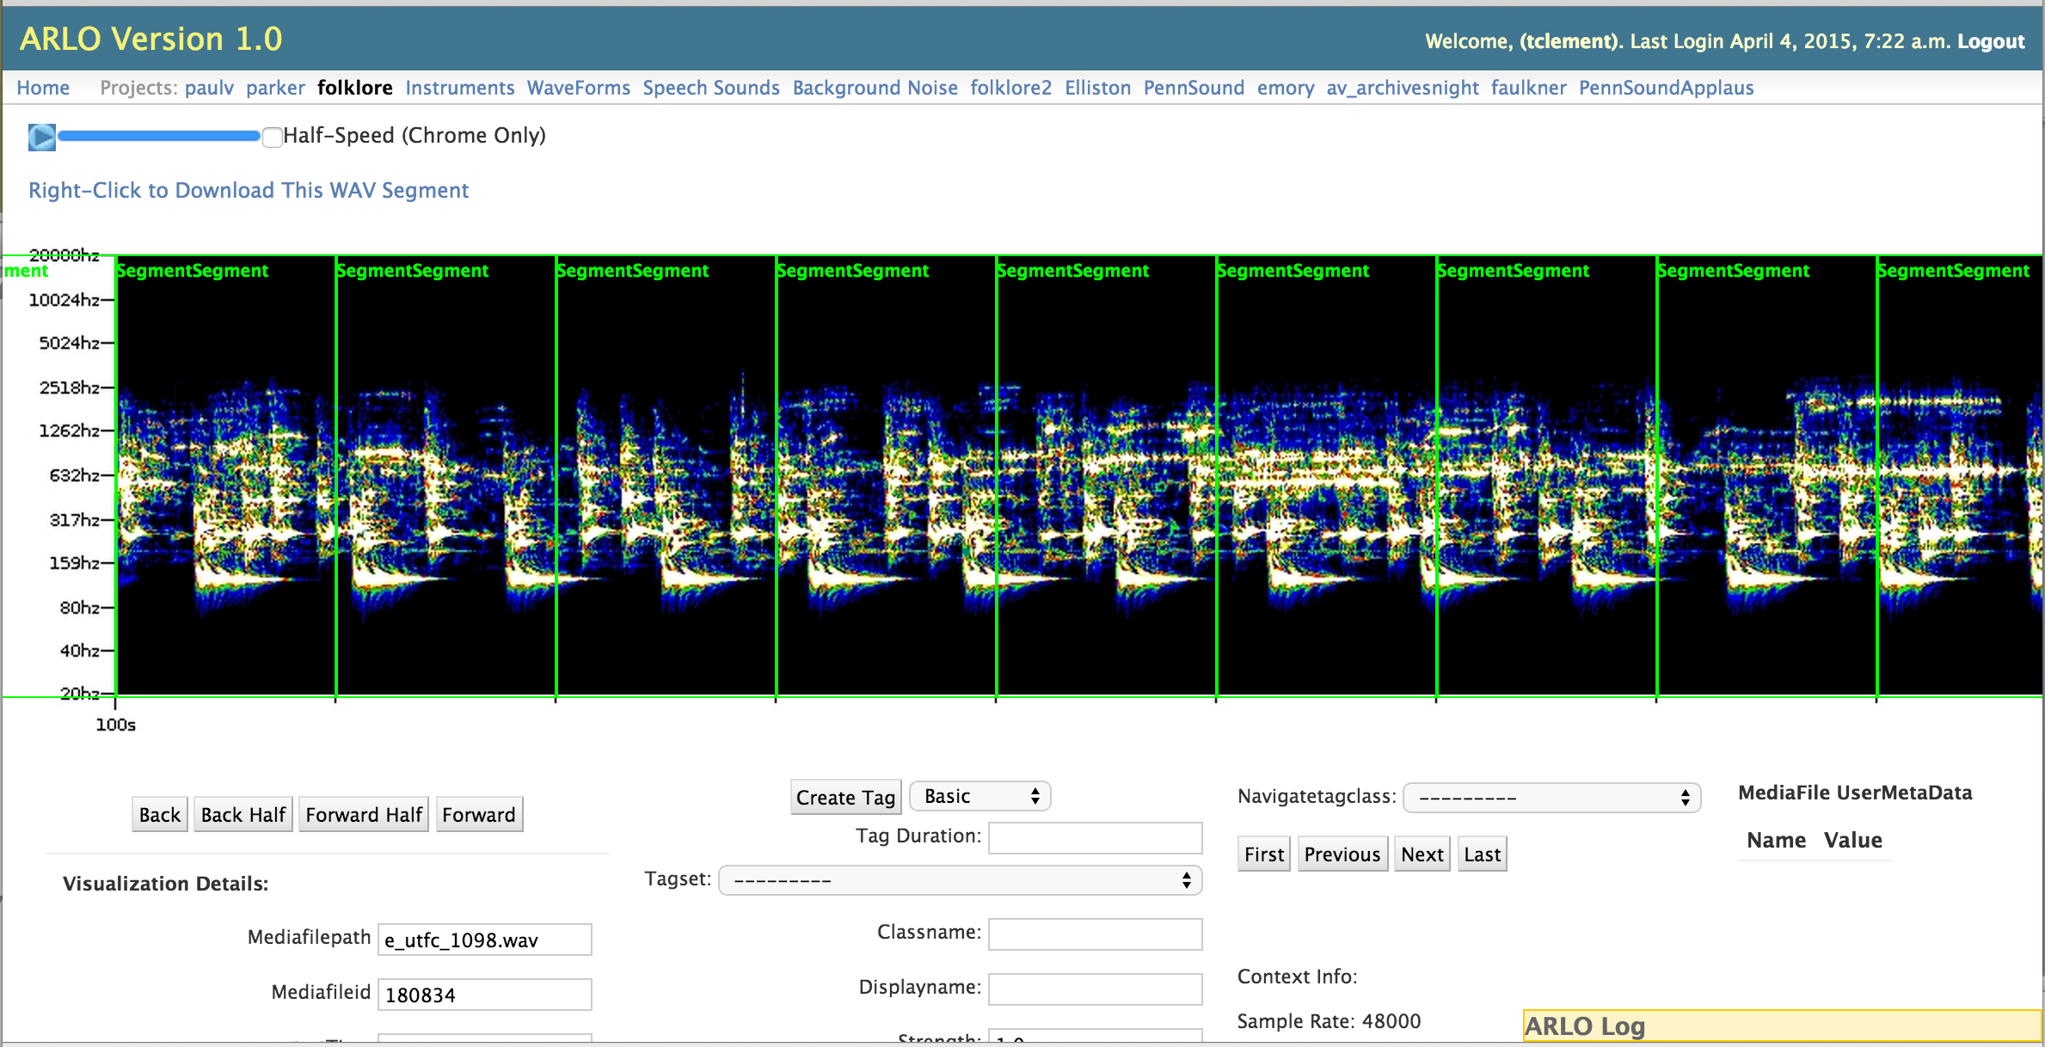
ARLO: dividing corpus into frames
.5 second time slices in ARLO

Slide 28
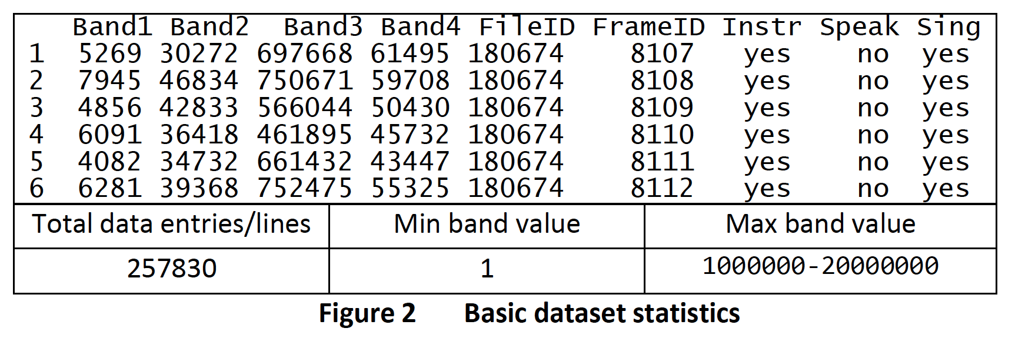
ARLO: creating the model
Detecting the energy of the wave form:
assumes basic physics about a microphone;
as the diaphram is stretched, the energy increases but it is also moving–
has both kinetic (how fast) and potential energy –
add them up and get total energy for each band at a point of time;
then sum them up into bins that are 1/32nd in size

Slide 29
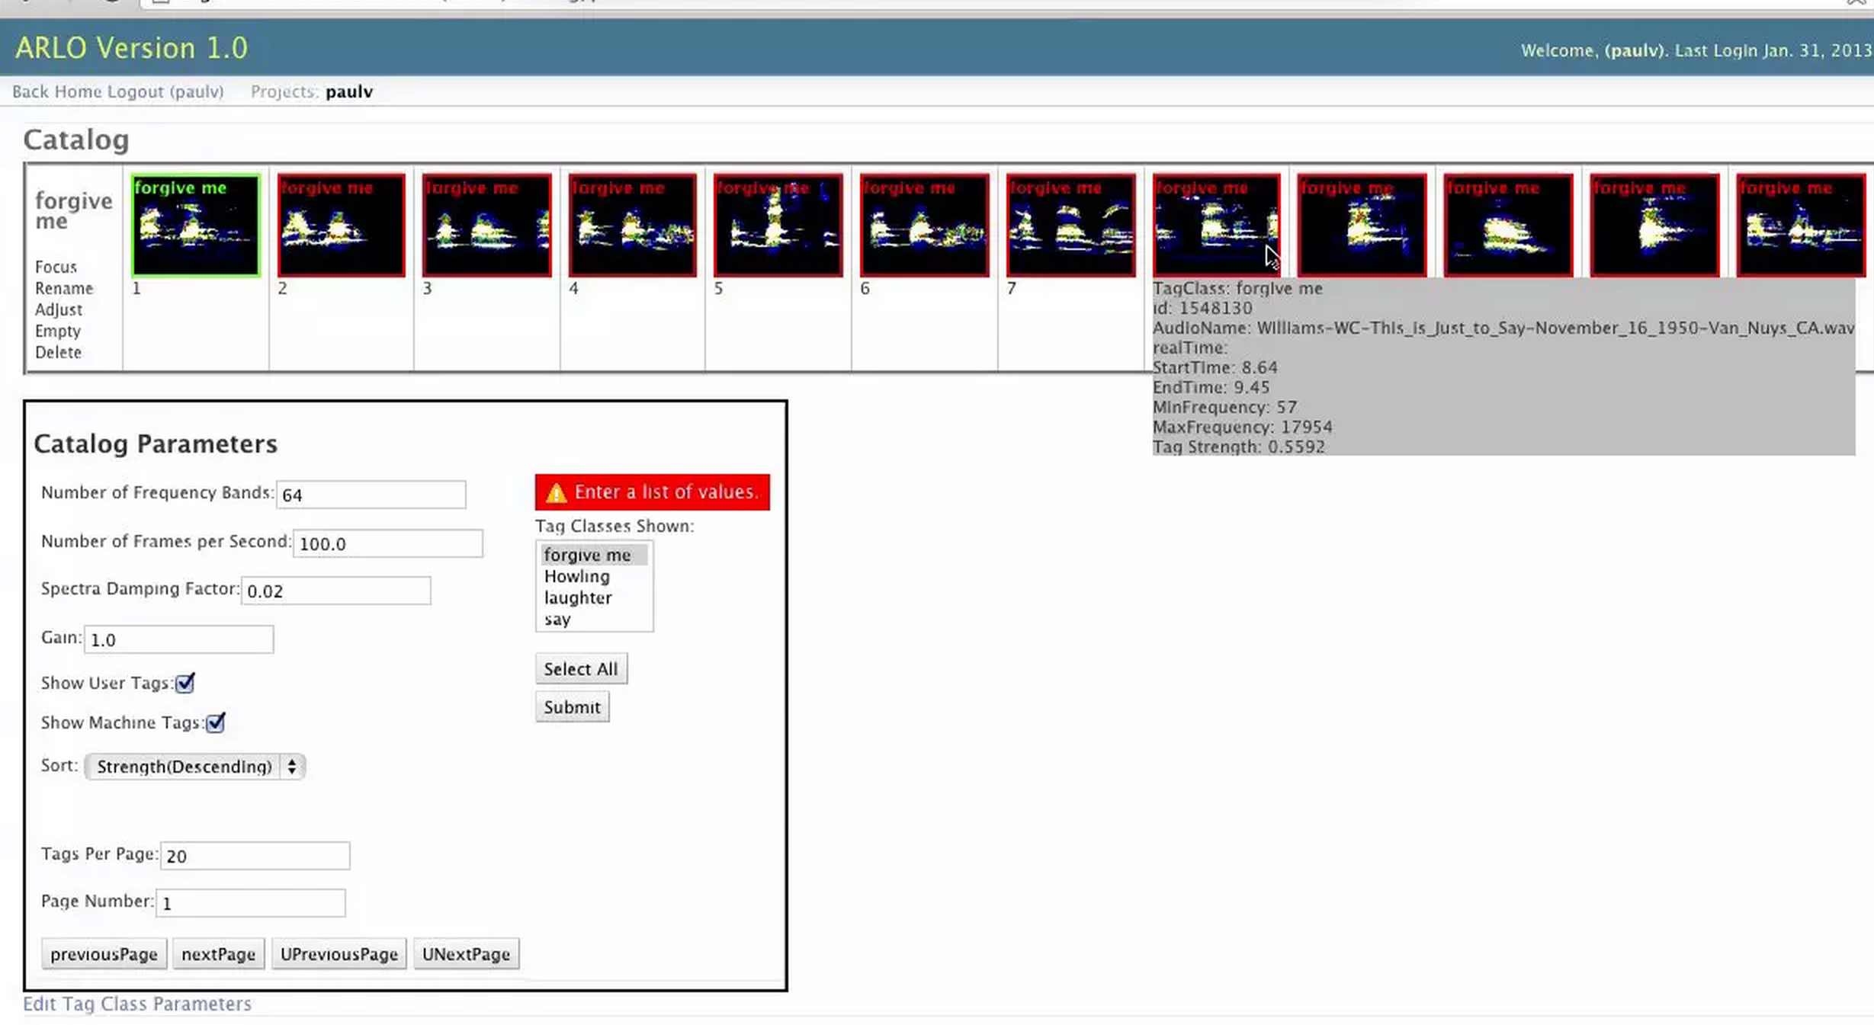
Run the model: classify
Stein
Laynor
OpenMary
Or . . . Searching sound with sound
Notes:
(city block, taxi cab distance, hamming distance [straight lines] -- [Euclidean is 2; as the crow flies]

Slide 30
ARLO instance-based learning (IBL) classification algorithm
Finds matches by taking each known classified example and "sliding" it across new audio files looking for good matches based on a distance metric.
Correlation between 64-band spectral vectors is calculated using Pearson's correlation coefficient (PCC), with each pair of corresponding bands considered a single observation.
Because PCC falls between -1 and 1, 1 is added to the correlation measure to produce a positive distance value.
Classification probability is then calculated using the continuous weighting approach (i.e., kernel density).
The class of each member of the training set is weighted according to its distance from the instance to be classified, with weight = 1.0 / (distance) ^ power, where power is determined by optimization.
Finally, the average of the weighted training set classes determines prediction probability.
Accuracy is determined by cross-validation on the training data, using the leave-one-out approach

Slide 31
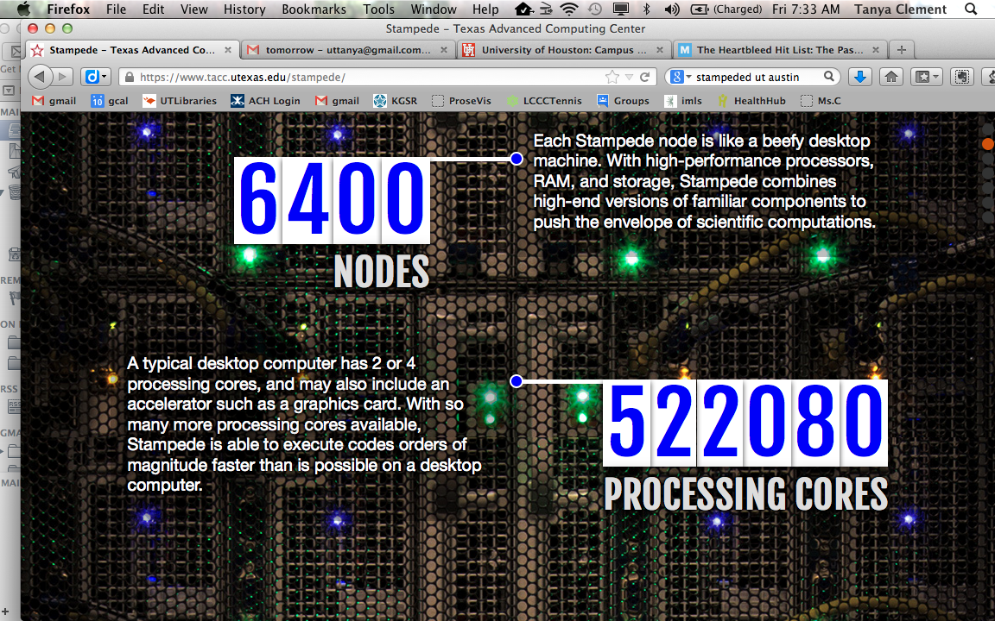
Running the model
http://www.tacc.utexas.edu/stampede
Notes:
we have two ways to parallelize; (1) a bunch of jobs, five files each; (2) spectral tags are multi-process; (3) clustering is still single threaded; At the peak, using 4 large memory nodes, a terrabyte of memory, each one with 32 processors (128 processors); gave each computer an even chunk of it; each machine was doing 100 files at once; 36 hours;

Slide 32
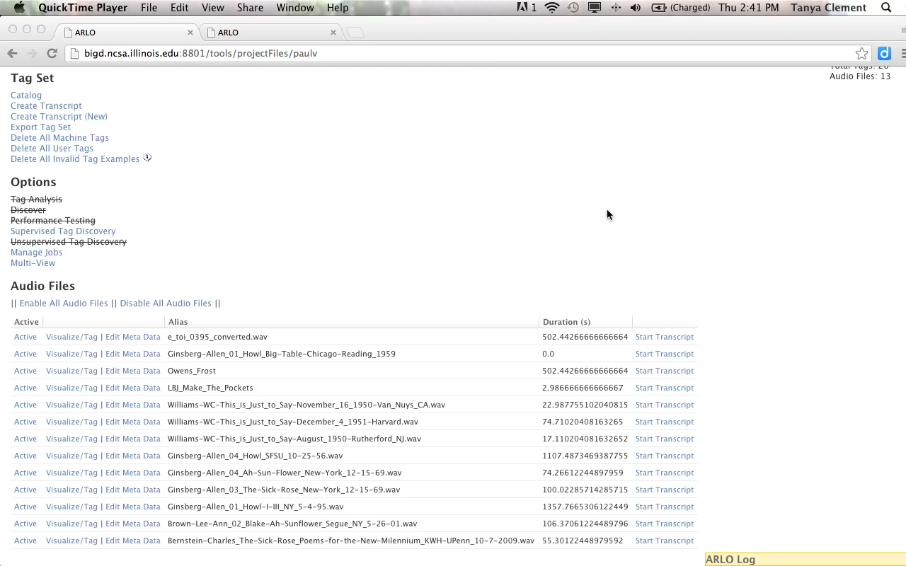
A Cautionary Tale
Finding “Forgive Me” in ARLO

Slide 33
Validate, re-run the model: reclassify
Stein
Laynor
OpenMary
Notes:
Perform machine learning with the instance based algorithm (with distance weighting power = 15 and threshold at .4 being optimal) using inductive biased optimization to come up with configuration; all machine learning algorithms have control parameters -- you need to try out different ones to find out what is optimal for your problem (classification threshold and distance weighting power) file-based cross validation was used to measure predictive performance; simulate the process for having the ground truth from other files and see how well you can predict it; applied the model to all the files (25 million examples); For each example in the file (an example is a 1/32nd second), we classify every example. To classify the time slice: compare it to all known slices and compute the distance between it and all known slices; computing the distance for 256 bands is 256 values (feature space has 256 dimensions in it); when we compute the distance, we are computing the distance between two points in a 256-dimensional space; this means for each dimension, compute the absolute value of the difference between each feature pair and then sum all the differences using the power of 1 (city block, taxi cab distance, hamming distance [straight lines] -- [Euclidean is 2; as the crow flies]) http://taxicabgeometry.net/general/basics.html After computing the distance, convert the distance into a weight; the weight for every example is derived from its distance 1/distance(raised to a power) [which in our case is 15]. [not using other predictions from near windows, previous or subsequent, to determine classes] Use the classes of all the examples and all of their weights to determine a “vote” for the current example; formula for the vote, single class probability: sum up (the actual class [0 or 1] times its weight) then divide by the sum of all weights; This creates a weighted prediction where some examples get more weight than others; [if you set it to 0 every slice would get the same weight]; ground truth is not taken out; [you will see perfect examples in the results;]

Slide 34
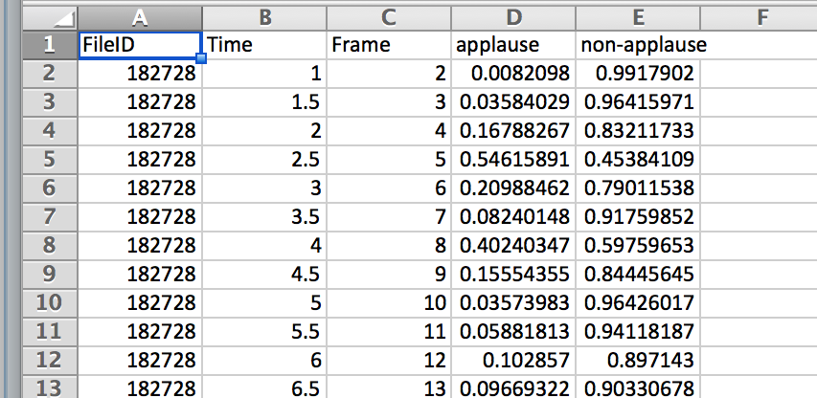
Export Results

Slide 35
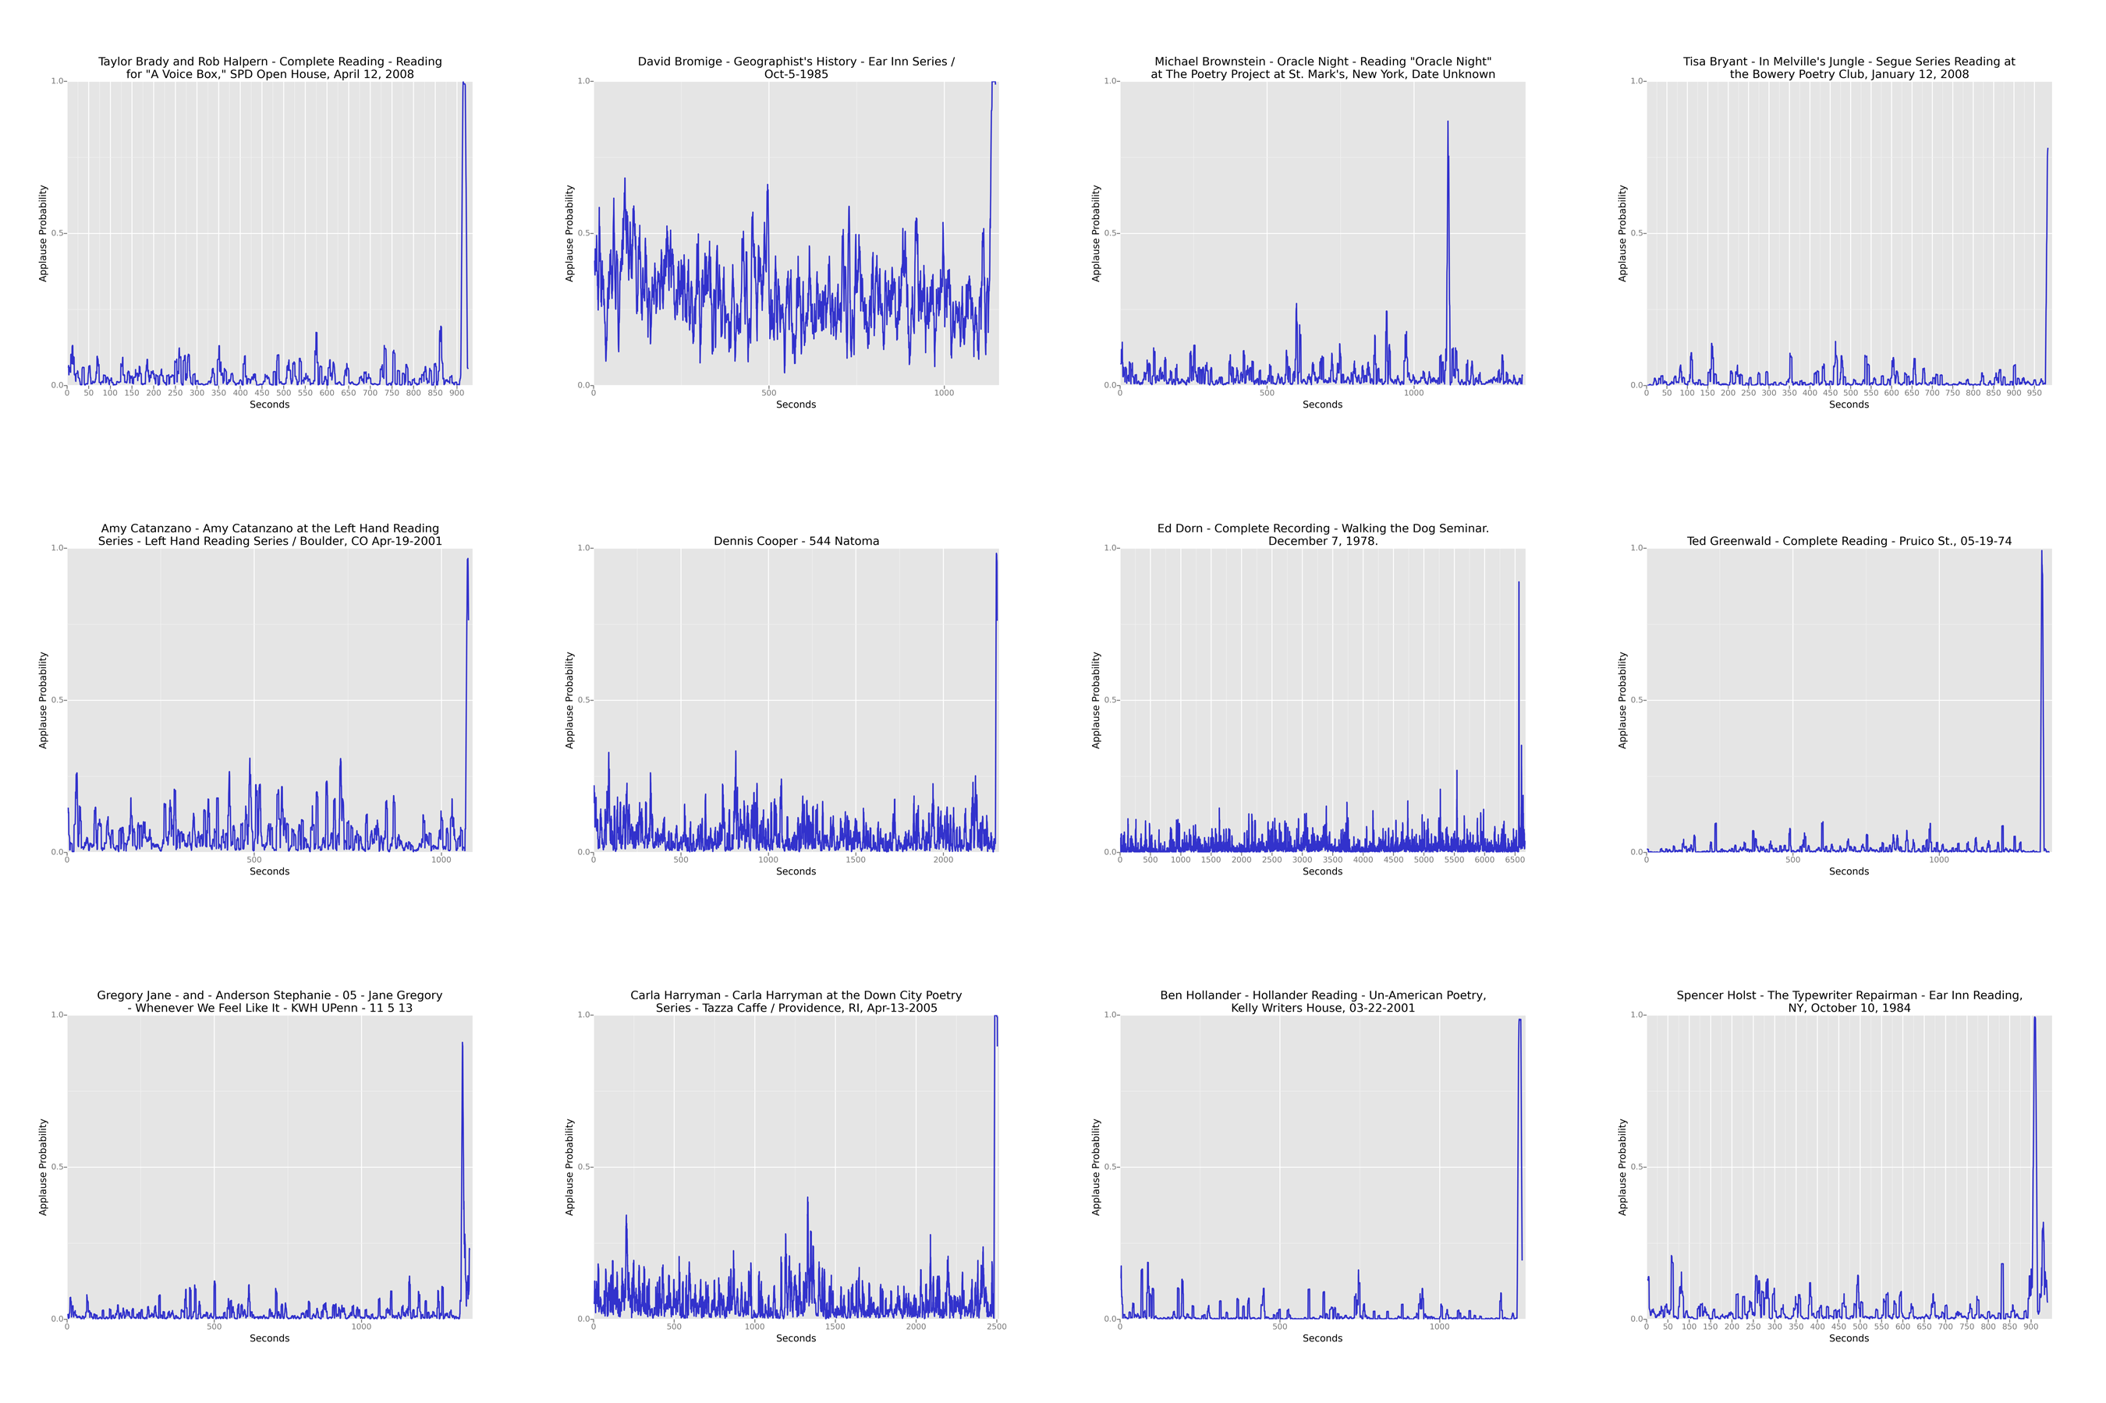
Applause in PennSou: sinnd
Visualizing results, single files
Picture of time slices

Slide 36
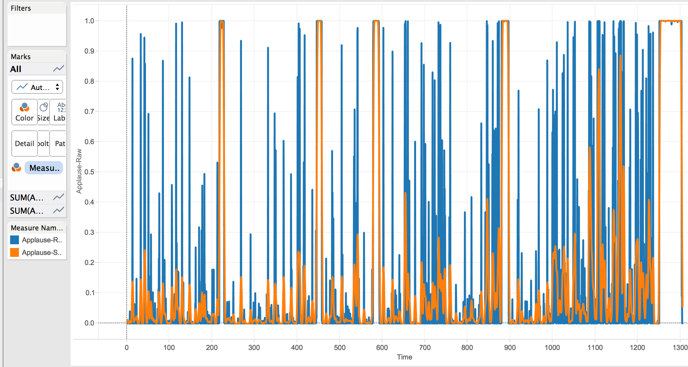
Smooth the results—7 seconds

Slide 37
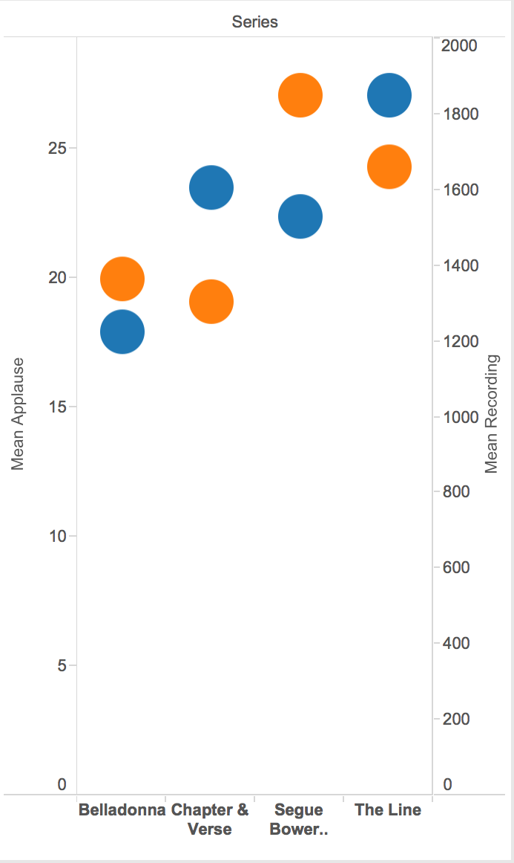
Visualizing results, aggregate groups
Applause by Reading Series
Blue: mean applause length
Orange: mean recording length

Slide 38
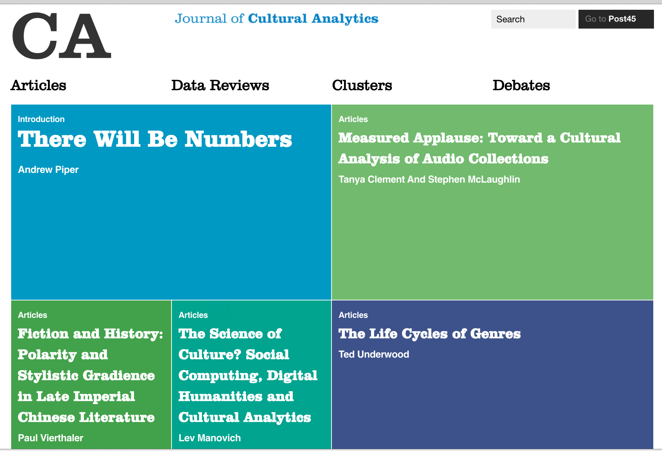
Publish
http://culturalanalytics.org/

Slide 39
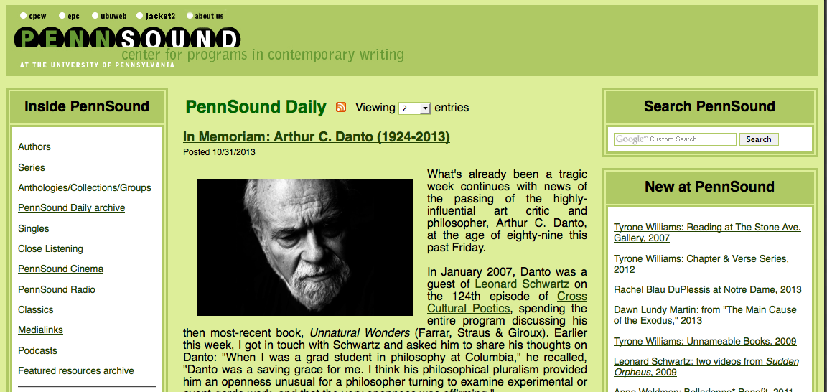
So? Applause in PennSound

Slide 40
Method
Ingested approximately 36,000 MP3s (6,200 hours) from PennSound into ARLO.
De-duplicated, 30,257 files remaining (5374.89 hours).
Chose 2,000 files at random, manually examined them for instances of applause, and
Chose one instance of applause per recording until we had an example training set of 852 three-second tags, including 582 3-second instances of non-applause (3492 0.5-second examples) and 270 3-second instances of applause (1620 0.5-second examples).
Optimized through 100 iterations. Used the following parameters:
0.5-second spectral resolution;
0.5 damping factor;
0.8 weighting power;
600 Hz minimum frequency;
5000 Hz maximum frequency;
64 spectral bands; spectral sampling rate of 2 (i.e., half-second resolution).

Slide 41
Smoothing and Cutoff(s)
Working with the results, we ran tests to understand the optimal smoothing window size and classification cutoff threshold
Created an evaluation set comprising 2,000 files from PennSound known to be full-length public poetry performances.
took place between the 1950s and 2010s all over the United States, falling predominantly in the Northeast
range in length from just a few minutes to over an hour
From these 2,000 readings we selected 10,000 half-second clips at random, manually classifying each as either applause or non-applause. This body of ground truth data allowed us to compare model performance across the two dimensions of our parameter space: smoothing window size and classification cutoff threshold.
In addition to using a standard "flat" rolling average, we also compared the performance of Hann window smoothing.

Slide 42
ARLO Performance
non-applause dramatically outnumber applause in the recordings under study (applause = 1.15% of our ground truth set), overall accuracy is a poor measure of our models' performance
used the Matthews correlation coefficient (MCC) as an overall measure of model performance.
After comparing 676 configurations, we found that the optimal approach was using IBL with Hann smoothing over 14 windows (7 seconds) and a threshold of 0.6, achieving an MCC of 0.7606.

Slide 43
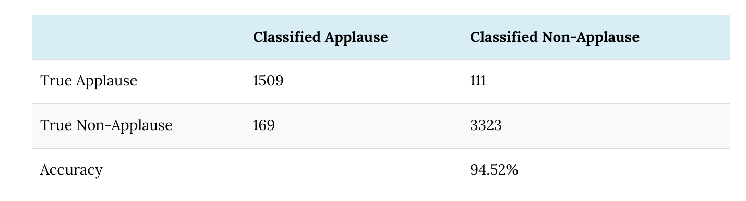
IBL Model Training Set Evaluation Confusion Matrix; Average Over 852 Folds

Slide 44
So, we can do it, but why?
Applause as delimiter between readings

